Slide 1
LAUNCH OF THE CIRCULAR ECONOMY CLUB LIVERPOOL CITY REGION
Carl Beer, Chief Executive
Merseyside Recycling and Waste Authority

Slide 2
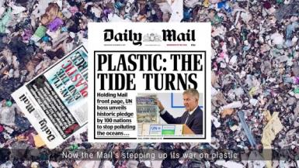
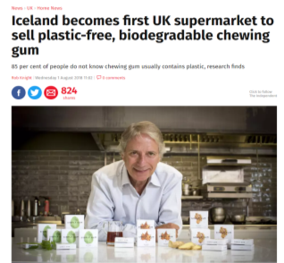
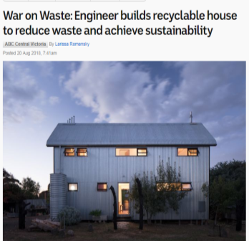
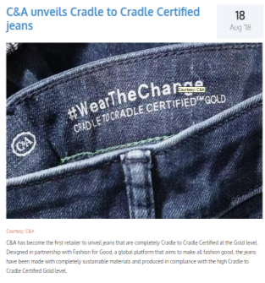

Slide 3
IT’S THE ECONOMY, STUPID
James Carville for Bill Clinton

Slide 4
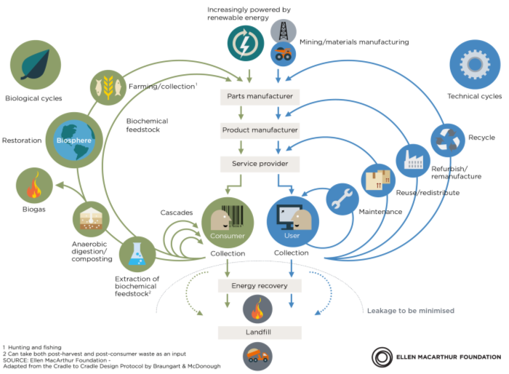
The circular economy
Circular economy: an industrial system that is restorative by design

Slide 5
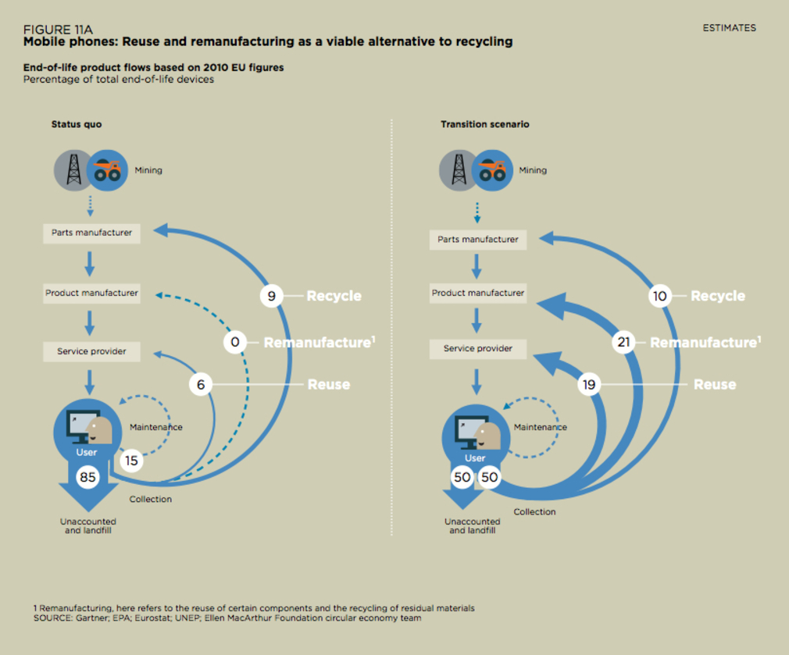
The circular economy

Slide 7
THE CIRCULAR ECONOMY
A move away from the linear ‘buy-use-dump’ consumer model
An economy where materials are re-used one, two, three, four or more times and kept in ‘high value ‘ use for as long as possible.
‘Every tonne a prisoner’
It’s about extracting the maximum ‘value’ from the resource

Slide 8
BENEFITS
Conserving valuable resources
Reducing environmental impact
Creating green jobs
Protecting businesses from ‘Resource Shock’, and
Saving money
Social value - keeping it in the local community

Slide 9
What does a Circular Economy look like?
A place where nothing is wasted – zero waste
Waste is being prevented/avoided
More material is being re-used, repurposed, and remanufactured than is being recycled
And, more material is being recycled than is going to Energy Recovery or Landfill
An economy where materials are re-used one, two, three, four or more times and kept in ‘high value’ use for as long as possible

Slide 11
Circular Economy EXAMPLES
Re-using
Cooking from leftover food
Repairing
Remanufacturing
Product design for longevity, recyclability
Process design and control for greater efficiency
Paying for the service not the product

Slide 12
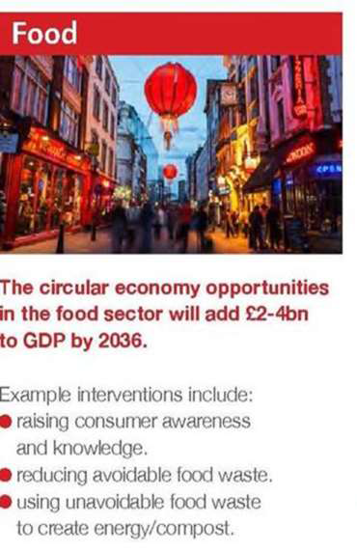

Slide 13
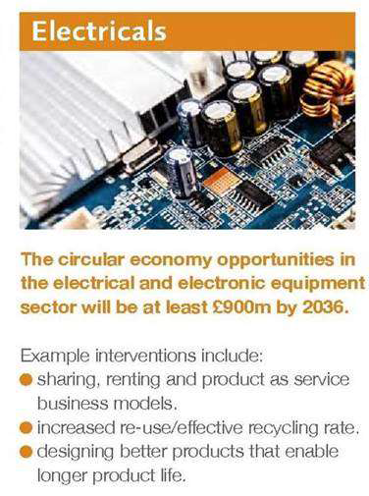

Slide 15
How much more ‘circular’ could household waste be?

Slide 16
The circular economy
BREXIT and supply chains for materials
E-commerce websites
GPS tracking
Online shopping
Online food shopping
3D printing at home
Paperless transactions
Electronic waste recovery
Leasing - from cars to clothes
Robotics and AI
Battery power storage

Slide 17
The circular economy
Closed loop systems – where waste from one process becomes the input to another process
Eco design
Focus on ‘quality’
Faster adoption of new technologies
Redesign of components, materials and products
Redesign of business processes (product as service)
Sustainable use of resources

Slide 18
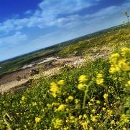
The circular economy club liverpool city region
The Circular Economy Club (CEC) is the international network of over 2,600 circular economy professionals and organisations from over 60 countries.
Non-profit | Global
Anyone can join online for free

Slide 19
The circular economy club liverpool city region
WHY establish a circular economy club?
Bring the local business community together to solve local challenges
when implementing the circular economy.

Slide 20
The circular economy club liverpool city region
Why establish a circular economy club?
Build on the enthusiasm, drive and expertise that’s already here.
Develop a forum to share and develop expertise and knowledge in the sustainable use of resources.
Develop and deliver resource management projects that reduce what we throw away, retain value and create employment.
Accelerate circular economy activities across the Liverpool City Region.
Share experiences and expertise
Learn from an international network of more than 2,600 circular economy professionals and organisations across 60 countries.

Slide 21
The Circular Economy Club Liverpool City Region
BECOME A MEMBER

Slide 22
The circular economy club liverpool city region
What’s in it for me?
Hear from practitioners who have already changed the way they do things
Check if your organisation is using resources in the most efficient way
Use circular economy thinking to:
Save money
Create jobs
Reduce impact on the environment
Create social value
Improve unique selling proposition (USP)

Slide 23
The circular economy club liverpool city region
What’s in it for me?
Get access to best practice and toolkits to help you improve performance
Get ideas to set your business apart from the crowd
Increase your business contacts
See the circular economy in action on the ground in the Liverpool City Region
Tell your story and promote better business

Slide 24
WHAT HAPPENS NEXT?
A PLAN FOR THE CEC LIVERPOOL CITY REGION – what’s next?
Join the CLUB: www.circulareconomyclub.com/s2-register
Join the CEC LCR Linkedin Group: www.linkedin.com/groups/8685207
Post case studies and best practice
Signpost and publish the latest thinking and delivery
Canvass and poll members on issues
Host further events
Applying circular thinking practices to your business
Hear from experts and practitioners in the circular economy delivery
Develop and champion local examples of the circular economy in action
Celebrate and promote the success of local businesses
Opportunity for members to host further events and workshops
Network and share resources and advice

Slide 25
The circular economy club liverpool city region
JOIN AT:
https://www.circulareconomyclub.com/s2-register/
Then become our Friend:
https://www.circulareconomyclub.com/members/tonyscott
CONTACT THE LIVERPOOL CITY REGION CLUB
Tony Scott, Coordinator CEC Liverpool City Region
Tel: 0151 255 2567
Linkedin: www.linkedin.com/in/tony-scott-b04306167
Email: cec.liverpoolcityregion@gmail.com
GET INVOLVED WITH CEC LIVERPOOL CITY REGION AT:
Linkedin: www.linkedin.com/groups/8685207

Slide 26
THE GOODS OF TODAY
ARE THE RESOURCE OF TOMORROW
AT YESTERDAY’S PRICES
Walter R Stahel

